Slide 1
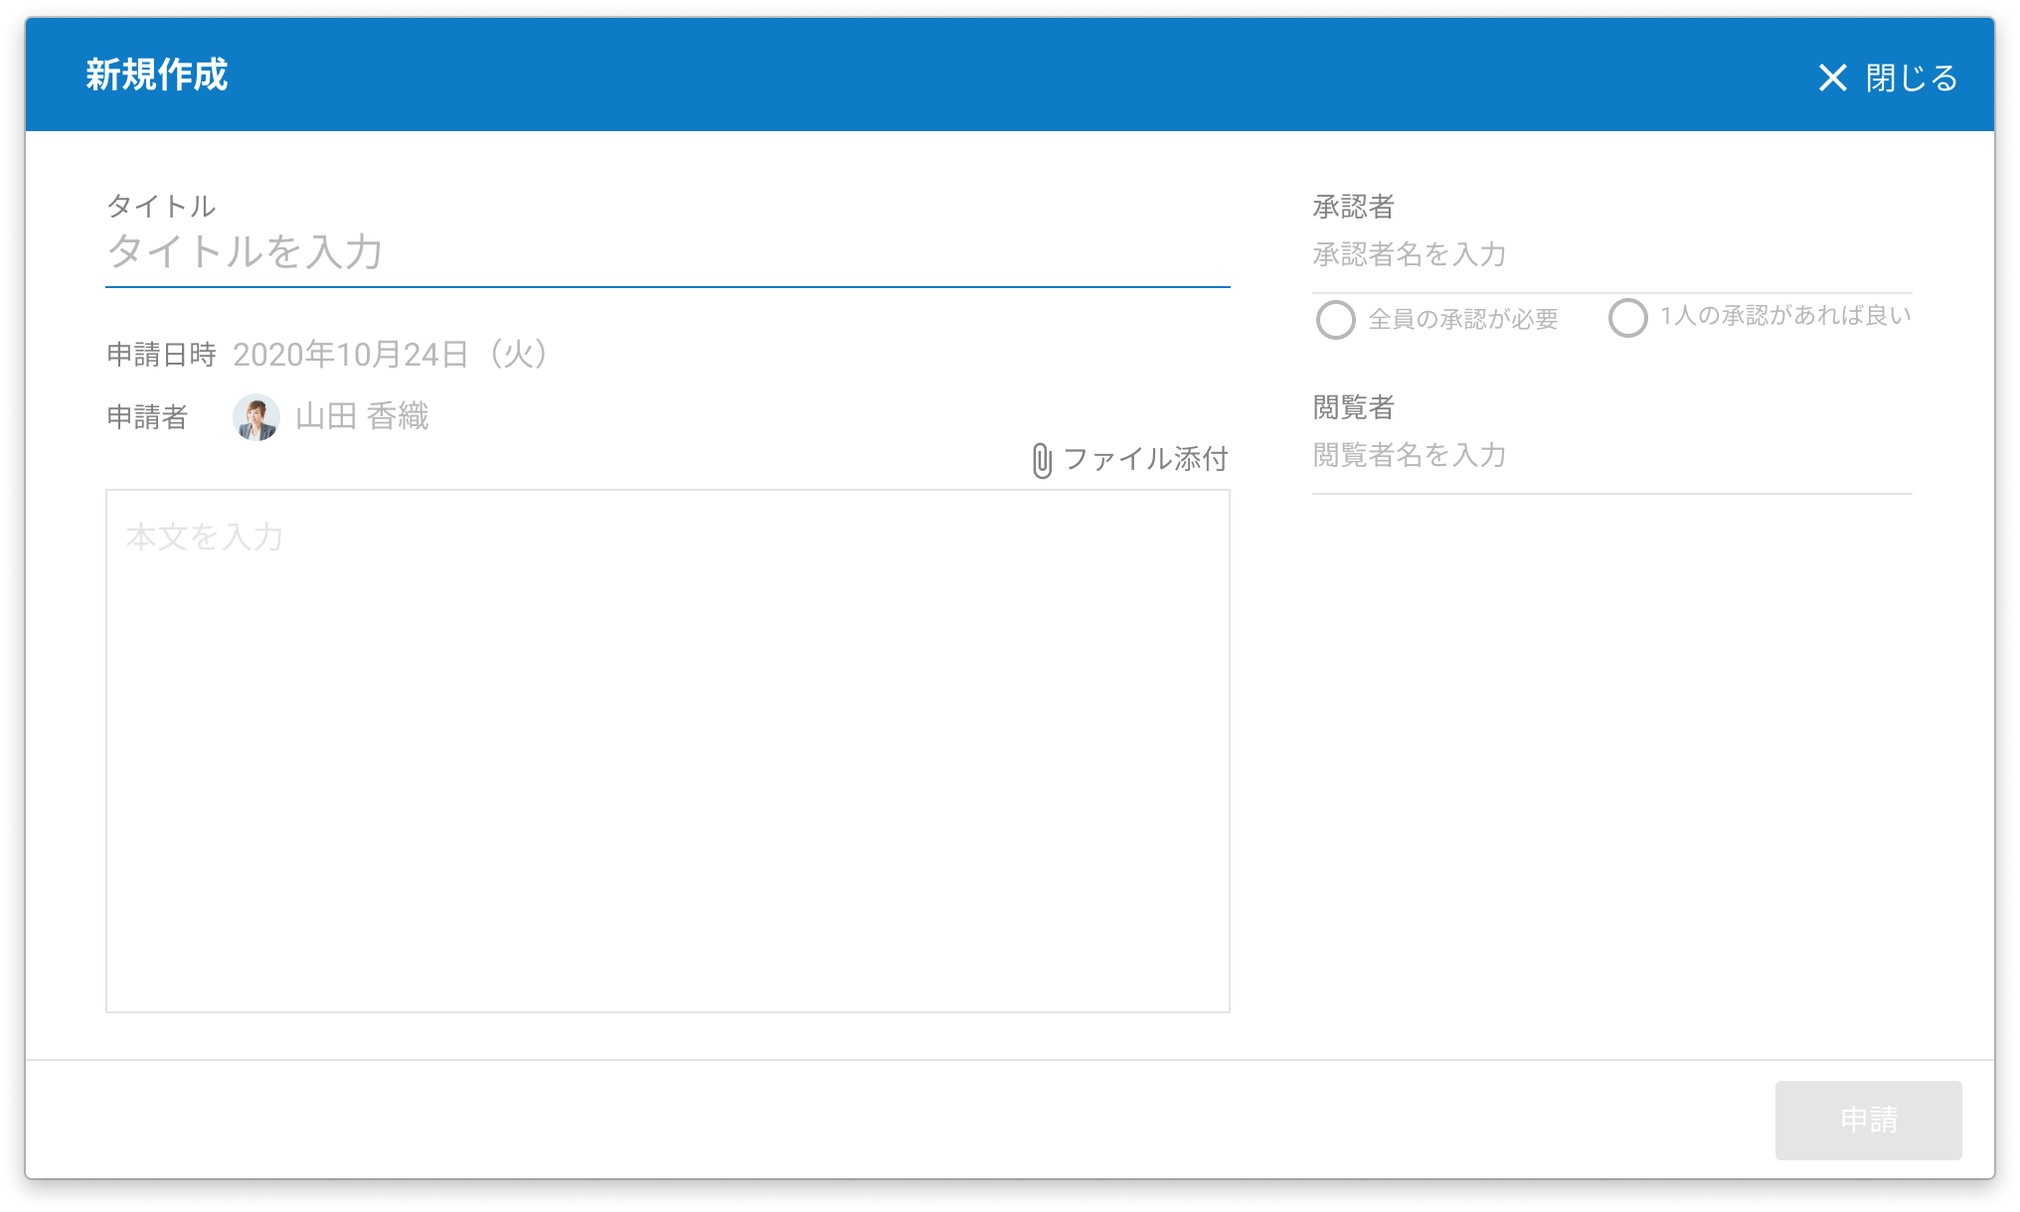
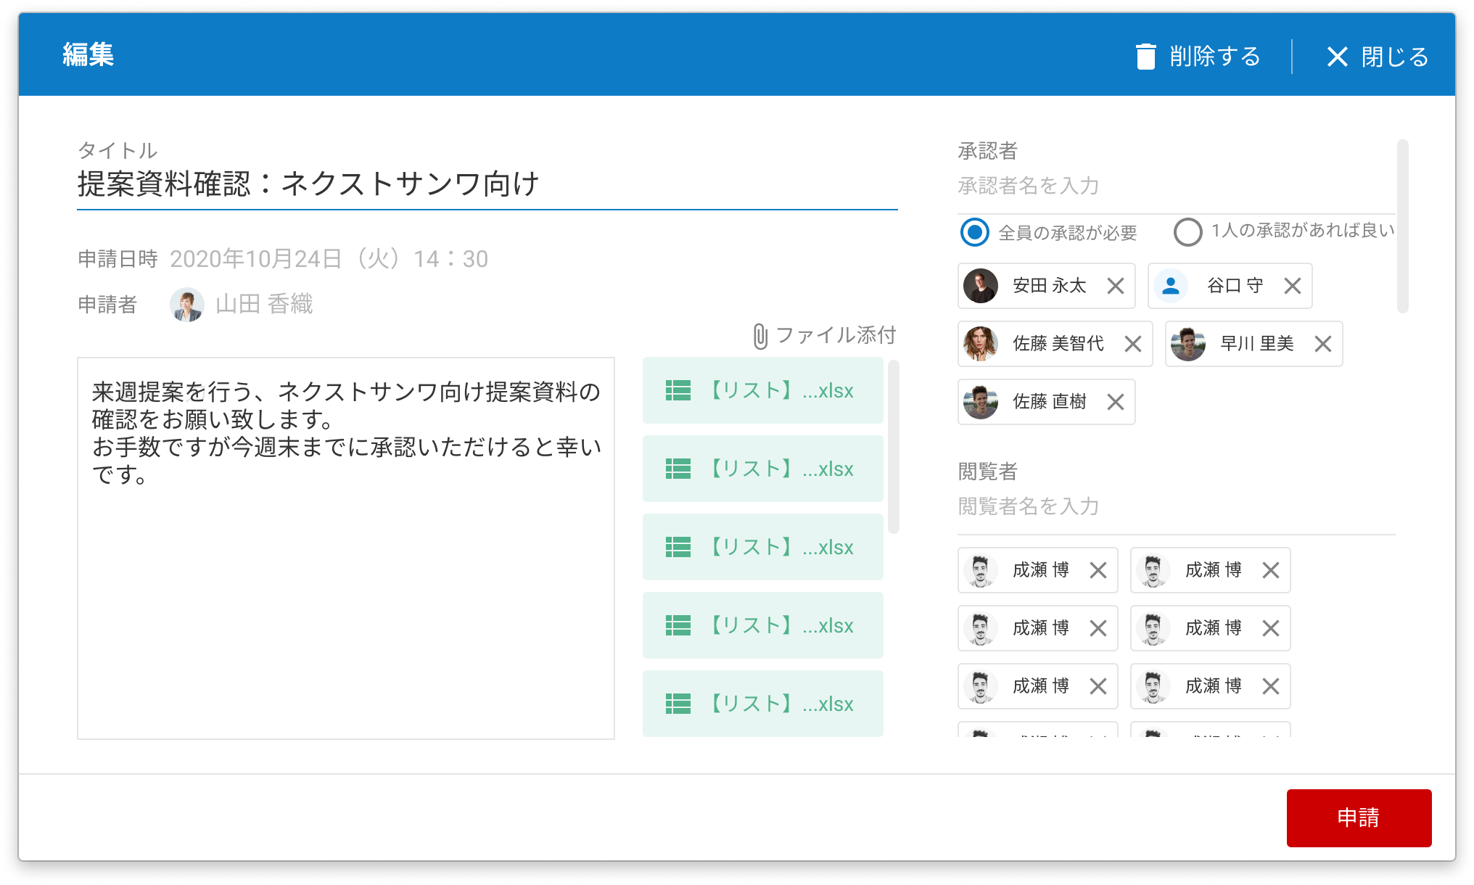
承認者_新規作成画面
承認者_編集画面
PAGE 13
When opening the new creation/edit screen, please make sure the input cursor is on the title.
Also, underline #0E7BC6 while the input cursor is on.

Slide 2

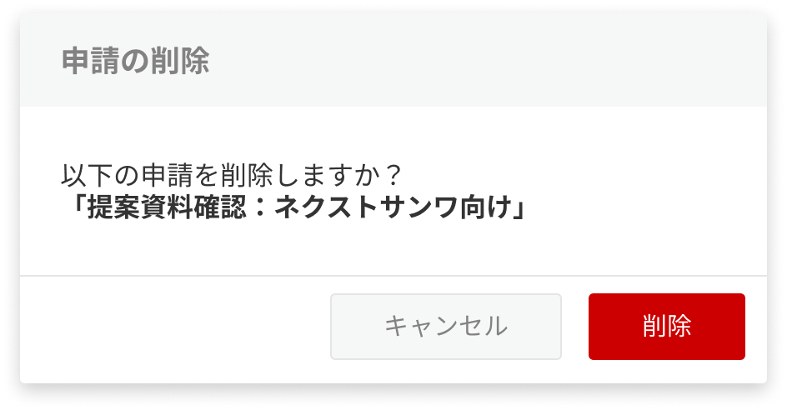
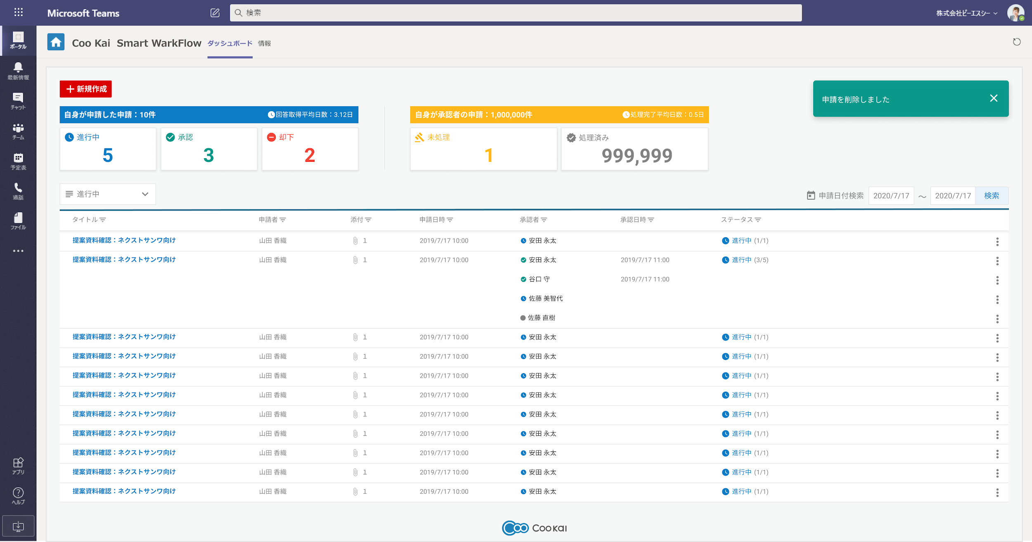
Confirming Deletion Screen
Toaster
PAGE 23
448px
56px
102px
364px
68px
64px
Frame drop-shadow(0px 2px 4px rgba(0, 0, 0, 0.1));
border-radius: 3px;
Headline
font-weight: bold;
font-size: 18px;
Title
～削除しますか？：
font-weight: normal;
font-size: 16px;
「申請タイトル」:
font-weight: bold;
font-size: 16px;
Delete Button
width: 100px; height: 40px;
font-weight: normal;
font-size: 15px;
Cancel Button
width: 139px; height: 40px; font-weight: normal;
font-size: 15px;
Frame box-shadow: 0px 4px 12px rgba(0, 0, 0, 0.2);
border-radius: 5px;
Title
font-weight: bold;
font-size: 18px;
Close icon(閉じるアイコン):close 24px

Slide 3
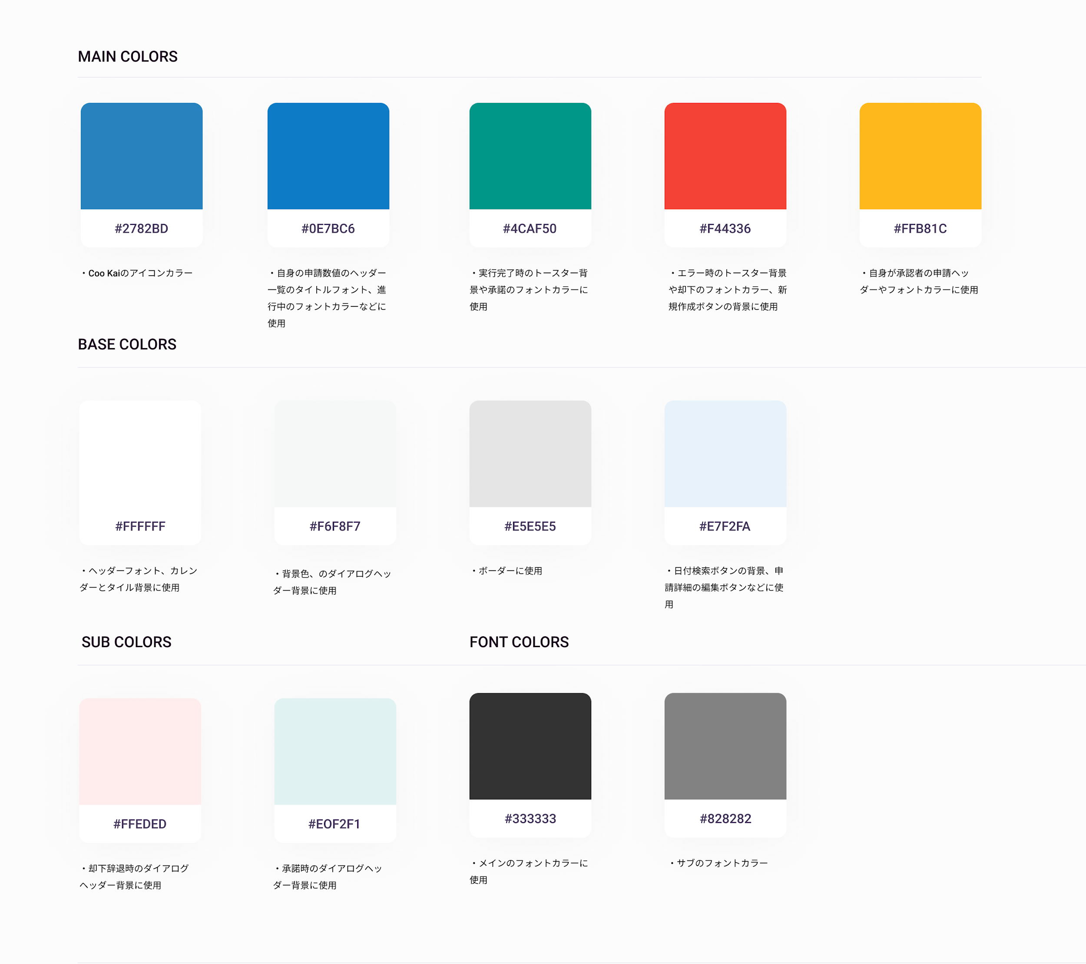
Colors for dashboard
・Icon color code : #2782BD
・User’s Header title : #0E7BC6
・Request in progress : #0E7BC6
・Successful toaster : #4CAF50
・Approved toaster : #4CAF50
・Error’s toaster : #F44336
・Header & font of requests when user is Approver : #FFB81C
・Header, font of calendar & tile’s background : #FFFFFF
・Background’s color & Dialog’s Header background : #F6F8F7
・Border : #E5E5E5
・Search button for date’s background, Edit request’s [edit] button : #E7F2FA
・Reject’s dialog header background : #FFEDED
・Approving’s dialog header background : #E0F2F1
・Font color for main : #333333
・Font color for sub : #828282

Slide 4
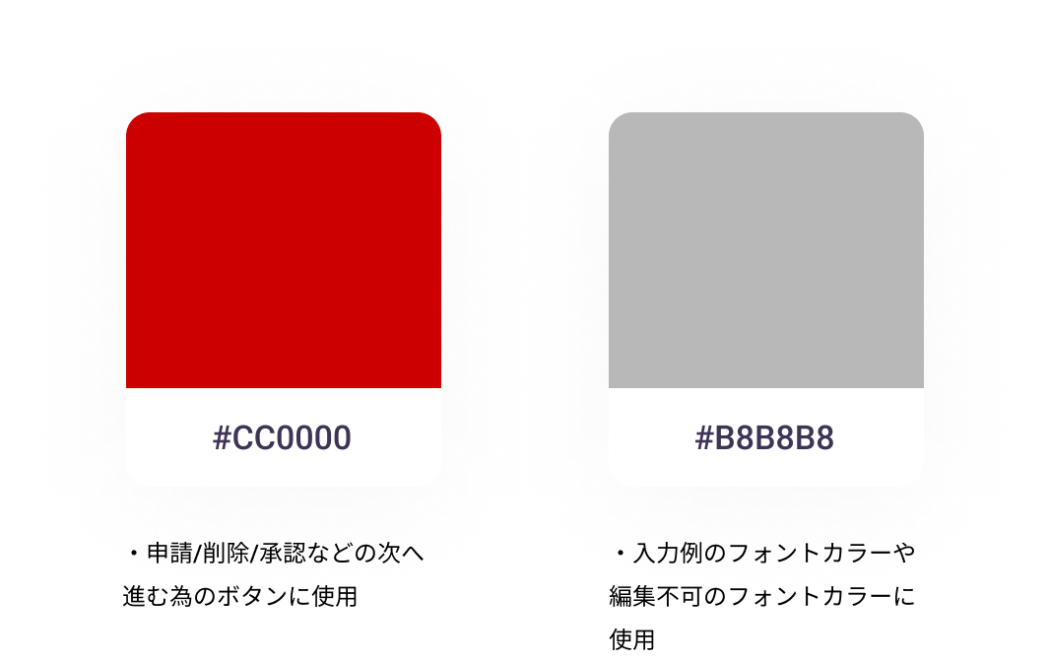
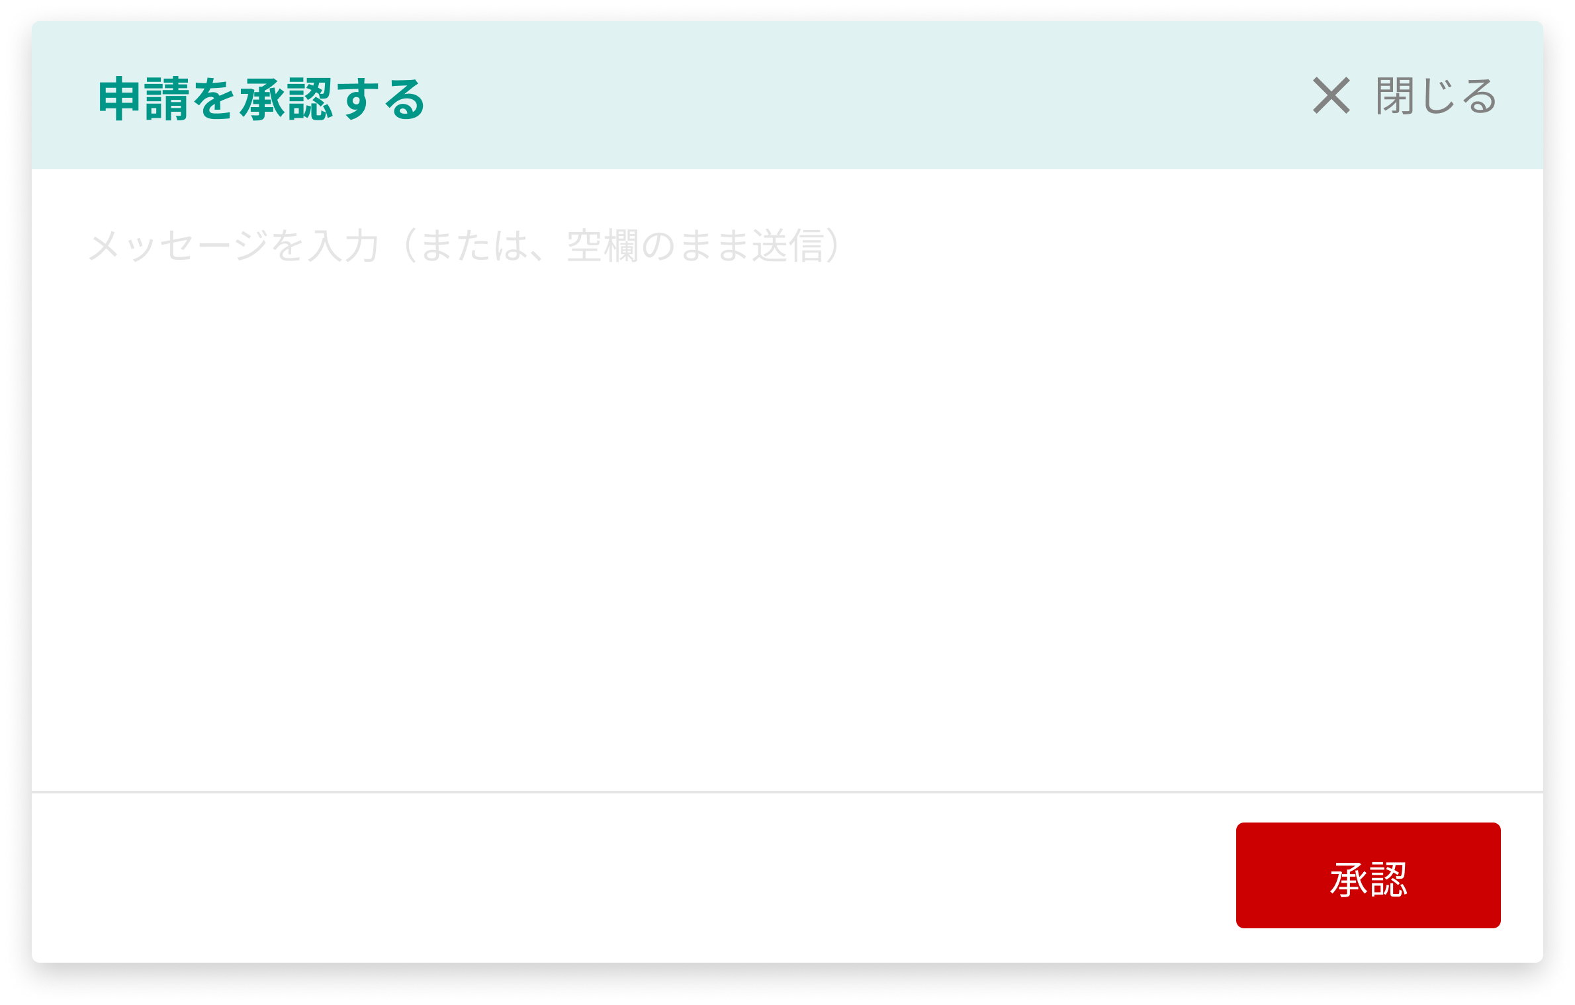
7/31Addition; Color_Example of use
・This red color will be use for Request, Delete, Approve & any other proceed button.
Request
Approve
#828282;
#828282;
#B8B8B8;
#B8B8B8;
#828282;
#B8B8B8;
#828282;
#B8B8B8;
All color is #E5E5E5;
・Use this color for font color of input example and non-editable font color.
・Color for the lines (partition)

